Slide 1
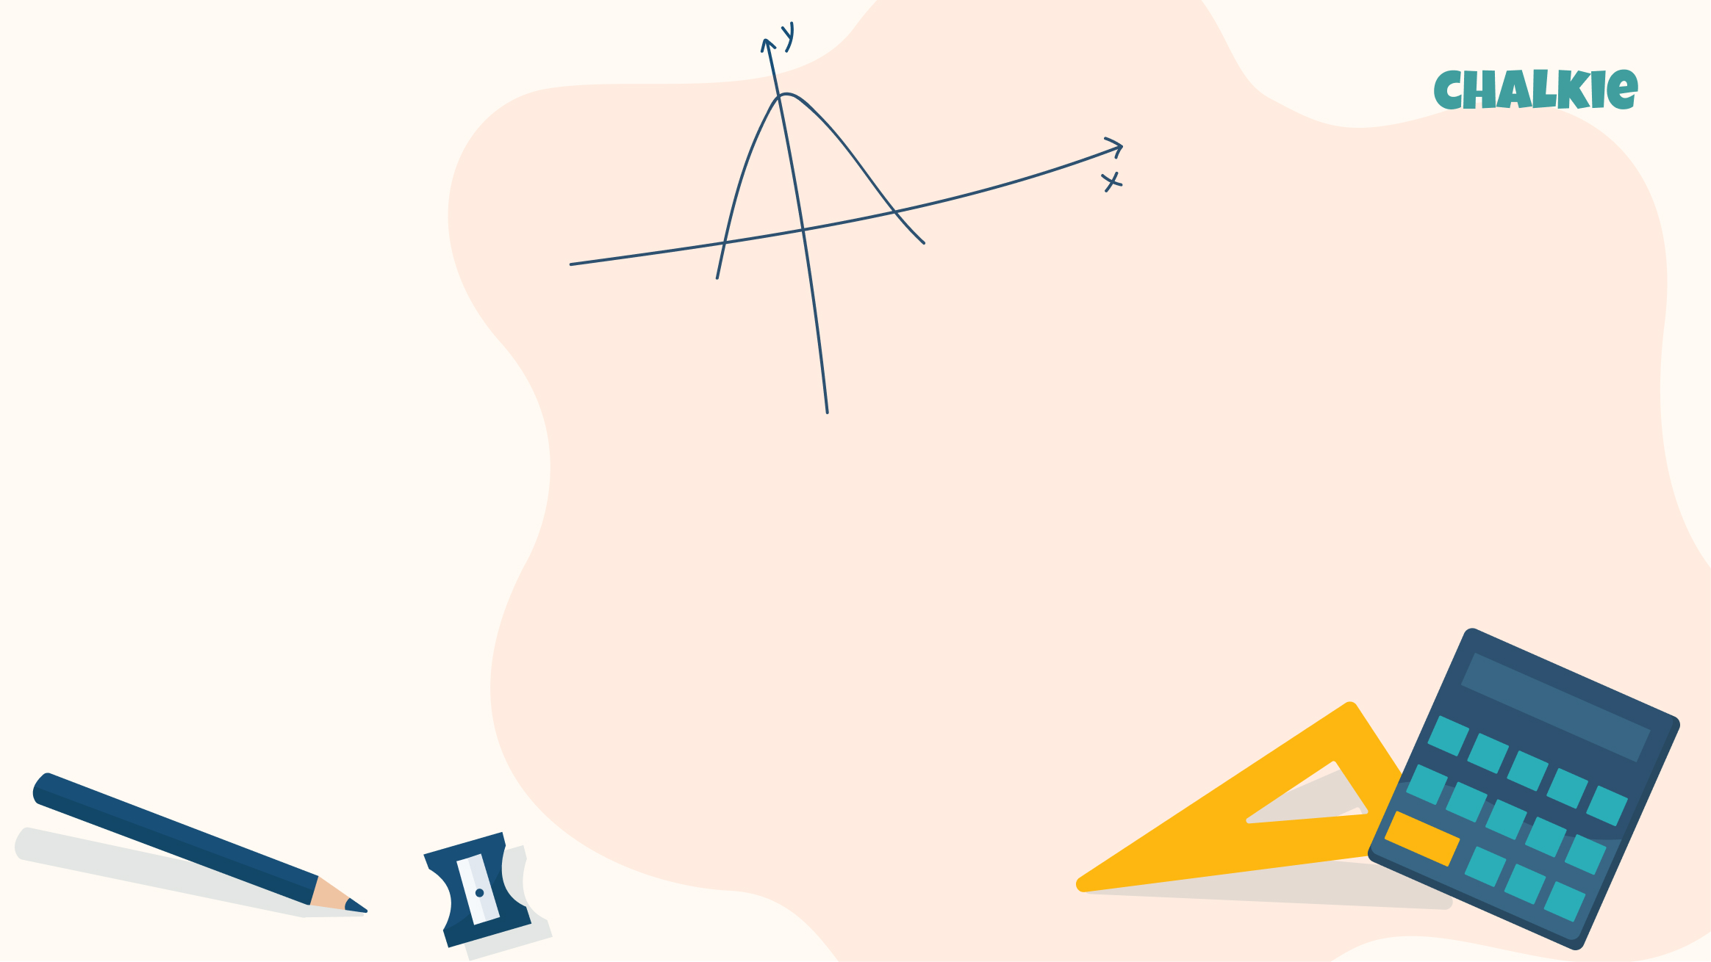
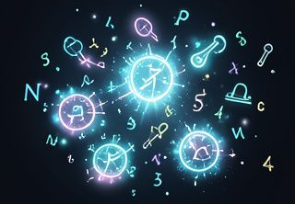
Exploring Exponents
Unlock the Power of Repeated Multiplication

Slide 2

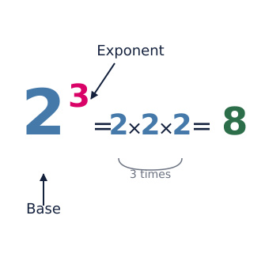
What Are Exponents?
The Basics
An exponent tells us how many times to multiply a number by itself.
Why Use Them?
They are a shortcut! Instead of writing long multiplication strings, we use a small number above the base.
Key Terms
Base: The number being multiplied.
Exponent (or Power): The small number showing how many times.

Slide 3
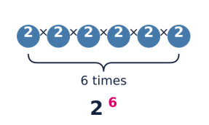

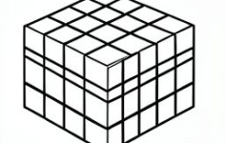
How to Read Powers
The Exponent is 2
We say 'squared'. Example: 5² is 'five squared'.
The Exponent is 3
We say 'cubed'. Example: 4³ is 'four cubed'.
Other Exponents
We say 'to the power of'. Example: 2⁶ is 'two to the power of six'.

Slide 4
Expanding Powers
Writing it Out
To solve an exponent, expand it into a multiplication sentence.
Example: 3⁴
This means the base 3 is used 4 times.
3 × 3 × 3 × 3
Now calculate the product.
Calculating the Value
Let's solve 3⁴ together.
3 × 3 = 9
9 × 3 = 27
27 × 3 = 81
So, 3⁴ = 81.
Your Turn
Try expanding 2⁵.
2 × 2 × 2 × 2 × 2

Slide 5
Quick Check
Answers on the next slide...
What is the value of 6²?
1.
12
2.
36
3.
64
4.
18

Slide 6
Quick Check
✅​
What is the value of 6²?
1.
12
2.
36
👍​
3.
64
4.
18

Slide 7
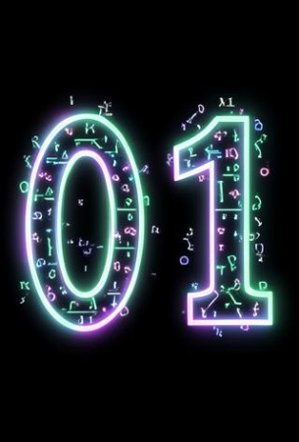
Special Rules to Remember
The Power of Zero
Any number (except 0) to the power of 0 equals 1.
5⁰ = 1
100⁰ = 1
x⁰ = 1
The Power of One
Any number to the power of 1 is just the number itself.
7¹ = 7
9¹ = 9

Slide 8
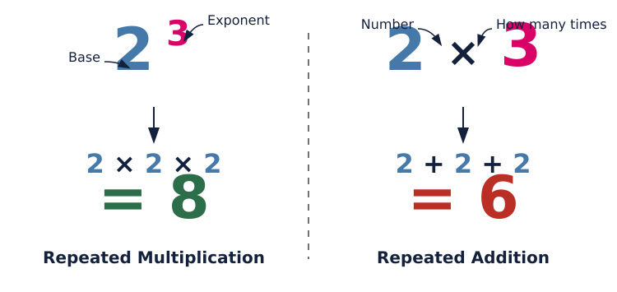
Comparing Powers

Slide 9

Fill in the blanks 🧩​
In the expression 5³, the number 5 is called the ____, and the number 3 is the ____. 5³ means 5 × 5 × ____, which equals ____.
Word bank 🏦​
base, exponent, 5, 125, power, sum, 3, 15
Answers on the next slide...

Slide 10
Fill in the blanks 🧩​
✅​
In the expression 5³, the number 5 is called the base, and the number 3 is the exponent. 5³ means 5 × 5 × 5, which equals 125.
Word bank 🏦​
base, exponent, 5, 125, power, sum, 3, 15

Slide 11
True or False and why? ✅​ ❌​ 🤔​
2³ is the same as 2 × 3.
👍​
👎​
TRUE
FALSE
Now it's time to explain why...

Slide 12
True or False and why? ✅​ ❌​ 🤔​
2³ is the same as 2 × 3.
👎​
Why is that?
a) False, because 2³ means multiplication (2×2×2), not adding.
b) True, because they look similar.
Answers on the next slide...

Slide 13
True or False and why? ✅​ ❌​ 🤔​
✅​
2³ is the same as 2 × 3.
👎​
Why is that?
a) False, because 2³ means multiplication (2×2×2), not adding.
b) True, because they look similar. ✅​

Slide 14
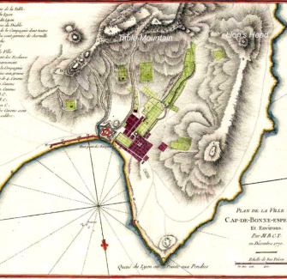
Summary
Key Takeaways
Exponents represent repeated multiplication.
The Base is the big number; the Exponent is the small number.
Squares (power of 2) and Cubes (power of 3) are common powers.
Remember: Any number to the power of 0 is 1!
Keep practicing to master these powerful numbers!

